Slide 1
FloodSaver - Drone-Assisted Flood Relief
Jhatin Sahoo
KV Kanchanbagh

Slide 2
The Need for Change: Challenges in Flood Rescue Operations
1. Rapid and Unpredictable Nature of Floods
- Flash Floods: Sudden onset of flash floods due to heavy rainfall, dam failures, or rapid snowmelt often leaves people unprepared and rescue teams overwhelmed.
- Challenge: Traditional rescue methods struggle to mobilize and reach affected areas quickly enough, especially in inaccessible or heavily flooded regions.
2. Limited Access to Flooded Areas
- High Risk to Rescuers: Flooded areas may have strong currents, submerged debris, or contaminated water, putting rescuers at significant risk.
- Challenge: Reaching stranded individuals without precise location data increases the time and resources required for effective rescue operations.
3. Inefficient Location and Communication with Victims
- Communication Barriers: In flood situations, mobile networks often fail, and victims may be unable to signal their locations, delaying the rescue process.
- Challenge: Rescue teams lack real-time data on individual locations, making it difficult to prioritize and respond efficiently.

Slide 3
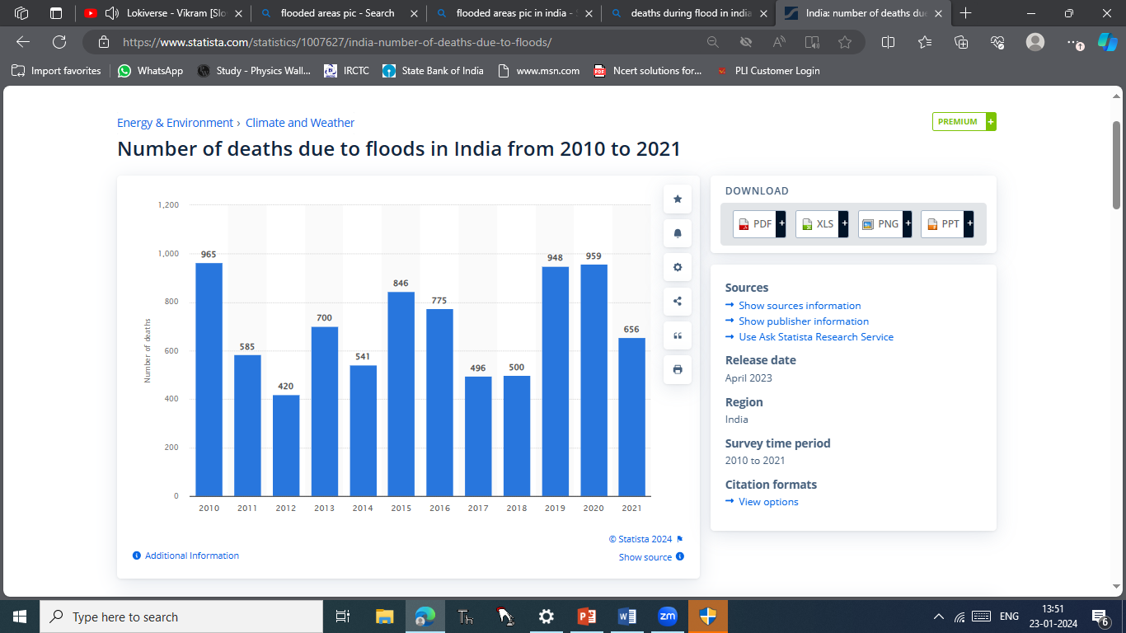
Impact of Floods: Statistics on Flood-Related Deaths
Global Impact: According to the World Health Organization (WHO), floods are the most frequent natural disaster worldwide, causing thousands of deaths annually.
Fatalities: Flood-related fatalities primarily stem from drowning, exposure, and injuries from debris. For example, drowning accounts for nearly 75% of all flood-related deaths.
India-Specific Data: India faces significant flood risk, with an average of 1,600 deaths annually due to flooding and extreme weather events, based on data from the National Disaster Management Authority (NDMA).
India-Death Rates

Slide 4
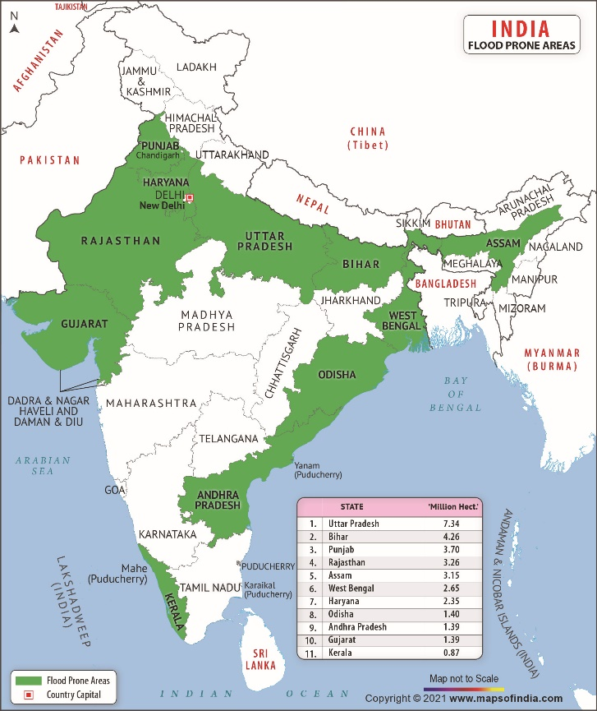
More about floods
Government Response:
Effective government response and coordination are vital during and after a flood.
This includes :
search and rescue operations,
providing emergency shelter and healthcare, and
implementing strategies for long-term recovery and rebuilding.
Flash Flooding:
Flash floods, characterized by a sudden and rapid onset of flooding, can be particularly deadly.
They are often triggered by:
heavy rainfall, dam failures, or
sudden thawing of snow,
catching people unaware and leading to a higher risk of drowning.

Slide 5
FloodSaver - Drone-Assisted Flood Relief
The idea of using drones for flood relief likely stemmed from
the need for more efficient disaster response
advances in drone technology
prior search and rescue efforts, and
a desire to innovate.

Slide 6
Proposed Idea
Using drones and sensors we are going to prepare a model which can help in rescuing the people who stuck.
Communicating with trapped individuals, accurately locating them, and relaying this data directly to NGOs for faster rescues.
Drone
➔
Individual
➔
➔
Location to NGOs
Rescue

Slide 7
Mechanism: How this Drone based system is going to work.

Slide 8
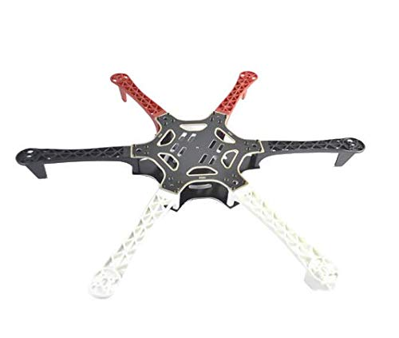
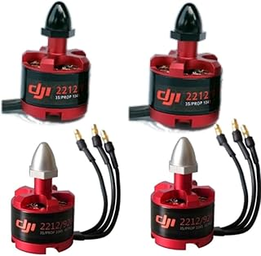
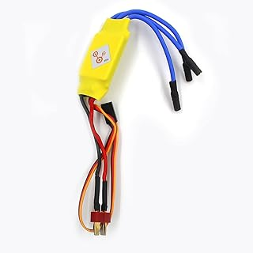
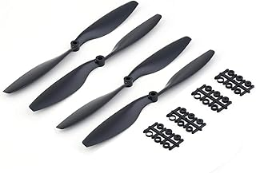

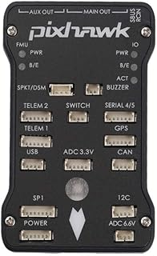
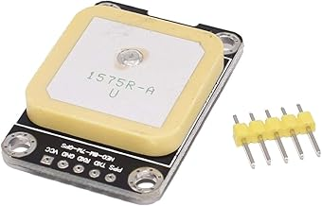
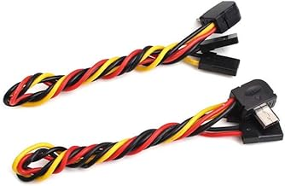
Essential Components and Sensors for Building FloodSaver: A Rescue-Ready Drone
F550 Hexacopter Frame
2212 Motors (920KV)
30A ESCs
1045 or 1145 Propellers (Carbon Fiber)
4S 5200mAh LiPo Battery
Pixhawk 4
Ublox M8N GPS Module with Compass
Runcam Split 3

Slide 9
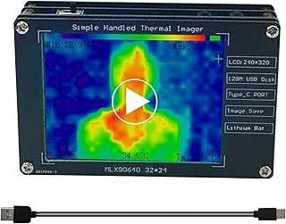
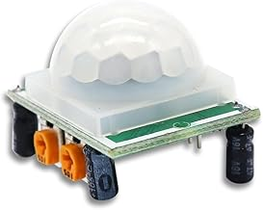
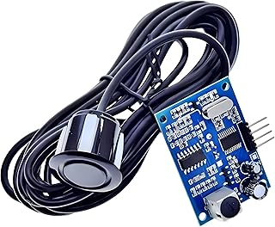
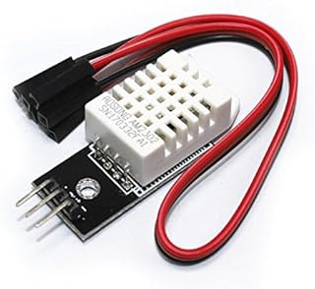
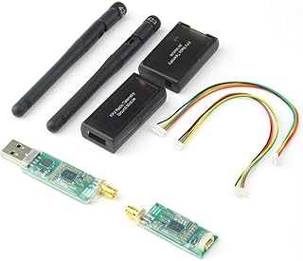
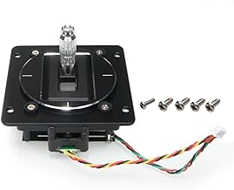
Essential Components and Sensors for Building FloodSaver: A Rescue-Ready Drone
Thermal Imaging Sensor
HC-SR501
Ultrasonic Water Level Sensor
Temperature and Humidity Sensor (DHT22
Radio Transmitter
433 MHz Telemetry Kit

Slide 10
Cost (₹) | Frame | 2,000 | | Motors | 4,500 | | ESCs | 3,000 | | Propellers | 500 | | Battery | 3,500 | | Flight Controller | 5,000 | | GPS Module | 1,500 | | Camera | 4,000 | | Thermal Imaging Sensor | 4,000 | | Additional Sensors | 800 | | Radio Transmitter & Receiver | 4,000 | | Telemetry Module | 1,500 | | Total | 30,300 |

Slide 11
Conclusions
Multifaceted Impact:
Floods have multifaceted impacts on communities, affecting public health, infrastructure, agriculture, and the economy. Recognizing these diverse consequences is crucial for comprehensive disaster preparedness and response.
Need for Resilience:
Building resilience in communities is essential to mitigate the adverse effects of floods. This involves not only addressing immediate concerns such as evacuation and emergency response but also implementing long-term strategies for infrastructure development and community education.
Climate Change Consideration:
The influence of climate change on the frequency and severity of floods underscores the importance of incorporating climate resilience into disaster management planning. Adaptation strategies should be implemented to address changing weather patterns.
Critical Role of Early Warning Systems: Early warning systems play a critical role in minimizing casualties during floods. Timely alerts can provide communities with the necessary information to evacuate and take preventive measures, reducing the risk of drowning and injuries.

Slide 12
1. Drone Frame - ₹2,000
- F550 Hexacopter Frame: This six-arm frame offers increased lift and stability, essential for carrying additional sensors and batteries.
- Material: Choose a frame with a mix of carbon fiber for durability and weight efficiency.
2. Brushless Motors - ₹4,500 (₹750 per motor, 6 motors total)
- 2212 Motors (920KV): Popular in larger drones, these motors provide sufficient lift for a fully equipped drone with rescue components.
3. Electronic Speed Controllers (ESCs) - ₹3,000 (₹500 per ESC, 6 ESCs total)
- 30A ESCs: Higher-rated ESCs handle greater loads and provide smoother control, especially beneficial in rescue scenarios.
4. Propellers - ₹500
- 1045 or 1145 Propellers (Carbon Fiber): Stronger, lightweight propellers for enhanced stability and durability.
5. Battery - ₹3,500
- 4S 5200mAh LiPo Battery: Extended capacity for longer flight times, especially with the extra payload.
- Consider purchasing a second battery for swap-outs, depending on how long each flight is planned.
6. Flight Controller - ₹5,000
- Pixhawk 4 or Holybro Kakute F7: These controllers offer advanced stability, support for GPS-based navigation, and are compatible with various rescue functionalities.
- Features include fail-safe modes, altitude hold, and return-to-home functionality, useful for unpredictable flood conditions.
7. GPS Module - ₹1,500
- Ublox M8N GPS Module with Compass: Better accuracy and faster fix times, which is crucial for rescue missions where pinpoint location accuracy is necessary.
8. High-Quality Camera - ₹4,000
- Runcam Split 3 or Caddx Tarsier: These dual FPV/HD cameras provide live streaming while recording high-quality video, allowing real-time monitoring and documentation.
- Includes a mountable gimbal if possible for stabilized imaging.
9. Thermal Imaging Sensor - ₹4,000
- Seek Thermal Compact Module: Attaches to the drone for detecting heat signatures, allowing identification of people in hard-to-reach or obscured areas.
- This addition is valuable for low-visibility conditions.
10. Additional Rescue Sensors
- PIR Motion Sensor - ₹200: Same HC-SR501, useful for basic detection.
- Ultrasonic Water Level Sensor - ₹300: Measures water proximity to understand environmental hazards.
- Temperature and Humidity Sensor (DHT22) - ₹300: Monitors conditions in real-time to assess safety.
11. Radio Transmitter and Receiver - ₹4,000
- FrSky Taranis Q X7 or FlySky FS-i6: Reliable control with good range, necessary for manual adjustments or overrides during missions.
12. Telemetry Module - ₹1,500
- 433 MHz Telemetry Kit: Transmits data like GPS location, sensor readings, and flight status to a ground station or mobile app, enhancing monitoring and control.
13. Ground Control Software (Free/Open-Source)
- Use software like Mission Planner or QGroundControl for planning and managing rescue missions, supporting real-time monitoring and automated waypoints.
---

Slide 13
Slide 1: Title Slide
Title: FloodSaver – Drone-Assisted Flood Relief
Include your name, institution, and the project’s primary goal: Revolutionizing Flood Rescue by Efficiently Locating and Assisting Individuals.
Slide 2: Problem Statement
The Need for Change: Explain current challenges in flood rescue—delayed responses, lack of precise individual location data, and communication barriers with affected individuals.
Include statistics on flood-related deaths and the primary causes to set a context for the problem.
Slide 3: Project Overview
Summarize the unique approach: Communicating with trapped individuals, accurately locating them, and relaying this data directly to NGOs for faster rescues.
Visualize the flow with a graphic showing Drone ➔ Individual ➔ Location to NGOs ➔ Rescue.
Slide 4: How FloodSaver Works
Step 1: Communication: Describe how drones can communicate with individuals using speakers or text-enabled displays.
Step 2: Location Detection: Explain the process of using GPS or thermal imaging sensors to identify individuals’ exact locations.
Step 3: Data Transmission: Detail how location data is shared with NGOs and emergency services for prompt action.
Slide 5: Key Technology and Sensors
List the drone and sensors:
Drone: DJI Matrice 600 or similar, with high payload and stability in adverse conditions.
Sensors: Include PIR sensors, thermal imaging, ultrasonic sensors for water level, and GPS for precise location.
Mention budget-friendly options under ₹10,000, emphasizing cost-effectiveness.
Slide 6: Real-World Application and Testing Plan
Propose pilot testing in controlled flood-prone areas.
Discuss collaboration with NGOs and local authorities for effective implementation and field data collection.
Highlight any anticipated challenges (e.g., signal issues, battery life) and how you plan to mitigate them.
Slide 7: Impact and Future Scope
Present the potential benefits: improved response times, lives saved, and more efficient allocation of rescue resources.
Future Innovations: Mention potential for AI-enhanced route optimization, automated data relays, or integration with broader disaster management systems.
Slide 8: Conclusion
Reiterate the key points: FloodSaver’s new approach to flood rescue, its feasibility, and its projected impact.
Invite questions or discussions, emphasizing your readiness to refine and adapt based on the interviewers’ feedback.

